Slide 1
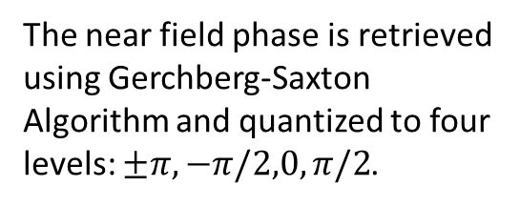
Far Field Image Generation (20 by 20 laser sites)
The near field phase is retrieved using Gerchberg-Saxton Algorithm and quantized to four levels: $±π, −π/2,0,π/2$.
Near Field Intensity (Uniform) and phase of the laser array
Desired pattern (left) and recovered pattern in the far field (Fourier Plane)
Assumed constant intensity maps for G-S iteration

Slide 2
Far Field Image Generation (20 by 20 laser sites)

Slide 3
From the phase map to imaginary gauge field design
Retrieved the phase
A Closed loop
Retrieve the loop?

Slide 4
Retrieve the amplitude of Near Field
An existed near field loop
Retrieve the amplitude
Desired Image
Far Field
An additional phase change mechanism is need to do the inverse engineering.
Recovered quality is bad, because G-S is hard to converge when used to recover amplitude

Slide 5
My plan:
Find the additional phase change method for the inverse engineering.

Slide 6
Full Flow of the Inverse Design
Near Field
Imaginary gauge field
FFT
FFT
FFT
I. Gerchberg-Saxton Phase Retrival
II. Nearfield Phase Quantization
III. Phase Modulated by Imaginary Gauge Field

Slide 7
Horizontal bar in the far field
Imaginary gauge field

Slide 8
Summary
The lasers are formed into a square circle with 10 sites in each side (for phase tuning). The far field only considers the contribution of the laser on this circle.
The near field phase retrieved by the G-S algorithm was quantized to three levels for phase modulation.
Tunable far field images generated by modifying the imaginary gauge field.
Further optimization can be achieved for more complex patterns (such as, discretize the phase into 5 levels and enlarge the laser array).

